Slide 1
MACHINE LEARNING · CLUSTERING ACTIVITY
Sorting 28,351 songs
by how they sound
Nobody told the computer what a genre is. We handed it nine numbers per
song and asked it to find the groups on its own.
K-Means · Gaussian Mixture · Spotify audio features

Slide 2
THE IDEA
What clustering actually is
Imagine emptying a box of Lego on the floor.
Nobody labelled anything. But you'd still start making piles — the flat ones here, the little ones there, the weird bendy ones in their own corner.
You didn't know the piles existed before you started. You found them by looking at what's similar.
That's clustering. Our Lego pieces are songs.
There is no right answer
No labels, no accuracy score, nothing to be marked against. Just piles, and whether they make sense.
So how do we know it worked?
Two ways: a number called silhouette, and whether we can look at a pile and give it a name.
clustering spotify songs
2

Slide 3
THE DATA
What we fed it
Same Spotify dataset from the EDA project, cleaned the same way.
28,351
9
100%
songs, after cleaning
numbers per song
of it we hid from the model
Dropped 5 rows with no title, one 4-second track, and every duplicate.
danceability, energy, tempo, valence, acousticness and four more.
The genre label. That was our answer key, saved for the end.
Three things we deliberately left out
loudness — it moves almost perfectly with energy, so it was the same fact counted twice.
key and mode — they're categories. The distance from "key 3" to "key 7" doesn't mean anything.
popularity — that's a result, not a sound. We checked it afterwards instead.
clustering spotify songs
3

Slide 4
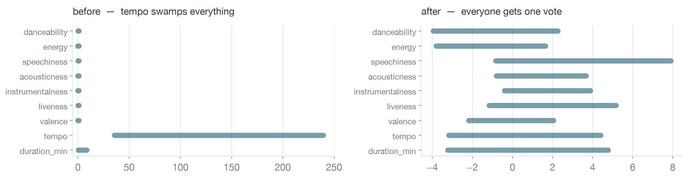
STEP 1 · SCALING
First problem: tempo was shouting
Tempo runs from 35 to 239. Danceability runs from 0 to 1. Clustering works on distance, so tempo alone would have decided every single group.
StandardScaler rewrites every feature as "how far from average". Now all nine argue at the same volume.
clustering spotify songs
4

Slide 5
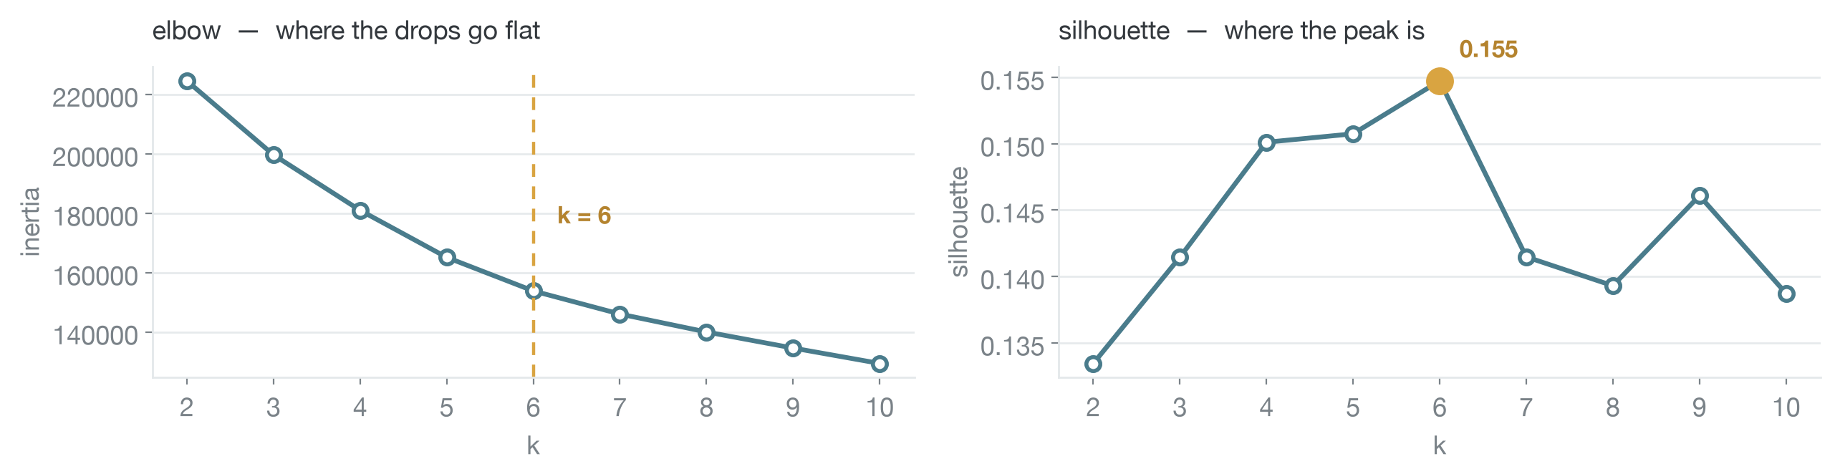
STEP 2 · CHOOSING K
Second problem: how many piles?
K-Means makes you say the number up front. So we tried every k from 2 to 10 and looked at two things.
Elbow: when does it stop helping?
Each new group tightens the piles less than the last one did. After 6, barely at all.
Silhouette: which k separates best?
Peaks at 6, then falls off a cliff at 7. Both point the same way, so k = 6.
clustering spotify songs
5

Slide 6
STEP 3 · FITTING
Two algorithms, same question
The activity asked for K-Means plus one more. We picked the one that could actually disagree with it.
K-Means
Gaussian Mixture
Drops 6 markers, everyone joins the nearest one, markers shuffle, repeat until nobody moves.
Assumes the piles are round and roughly the same size.
Assumes the data is a stack of overlapping bell curves and works out which bell made each song.
Allows stretched, lopsided, overlapping piles.
Why bother with the second one?
If our groups really were long stretched shapes, GMM would have won and we'd know K-Means was the wrong tool. That makes it a real test rather than box-ticking.
clustering spotify songs
6

Slide 7
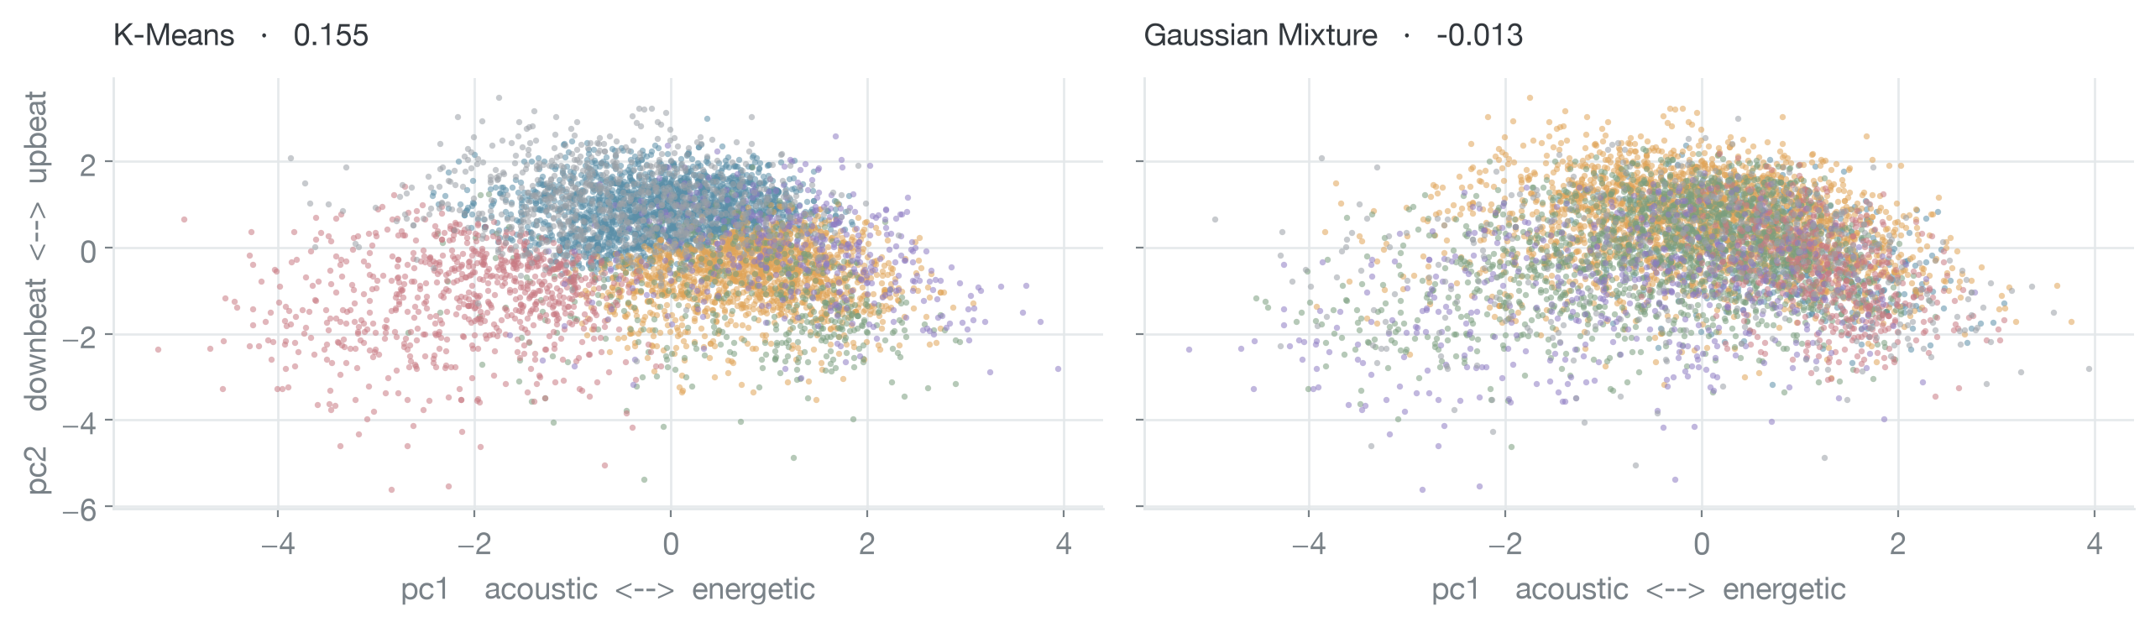
STEP 4 · LOOKING AT IT
And the winner is fairly obvious
Nine dimensions can't be drawn, so PCA squashed them to two. Think of it as walking around the data and finding the best angle for a flat photo.
Left: every colour holds its own territory. Right: confetti.
Fair warning — this photo only carries 36% of the real spread, so treat it as a sanity check, not proof.
clustering spotify songs
7

Slide 8
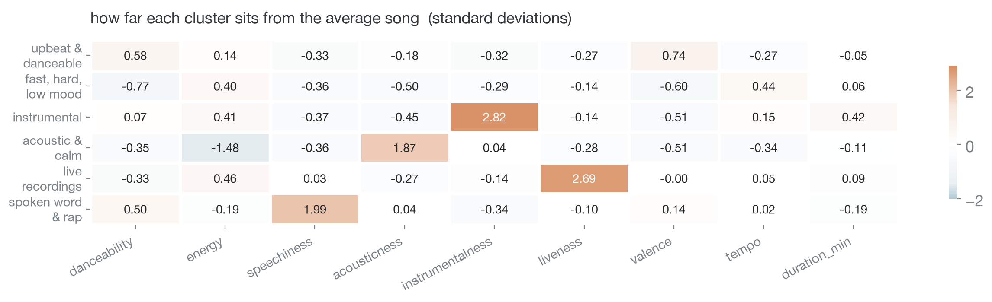
THE RESULT
Six groups, and each one has a personality
Read the dark squares. Every group is defined by one feature going loud.
instrumentalness +2.82 → instrumental. liveness +2.69 → live recordings. speechiness +1.99 → rap. acousticness +1.87 → acoustic and calm.
clustering spotify songs
8

Slide 9
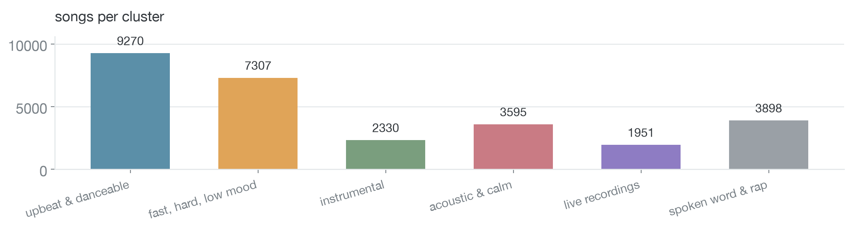
THE RESULT
How the songs split up
The biggest pile is the happy one
The most popular pile is the quiet one
9,270 songs — upbeat, danceable, high valence. Roughly a third of everything.
Acoustic and calm averages 42.7 popularity. Instrumental comes last at 29.7.
clustering spotify songs
9

Slide 10
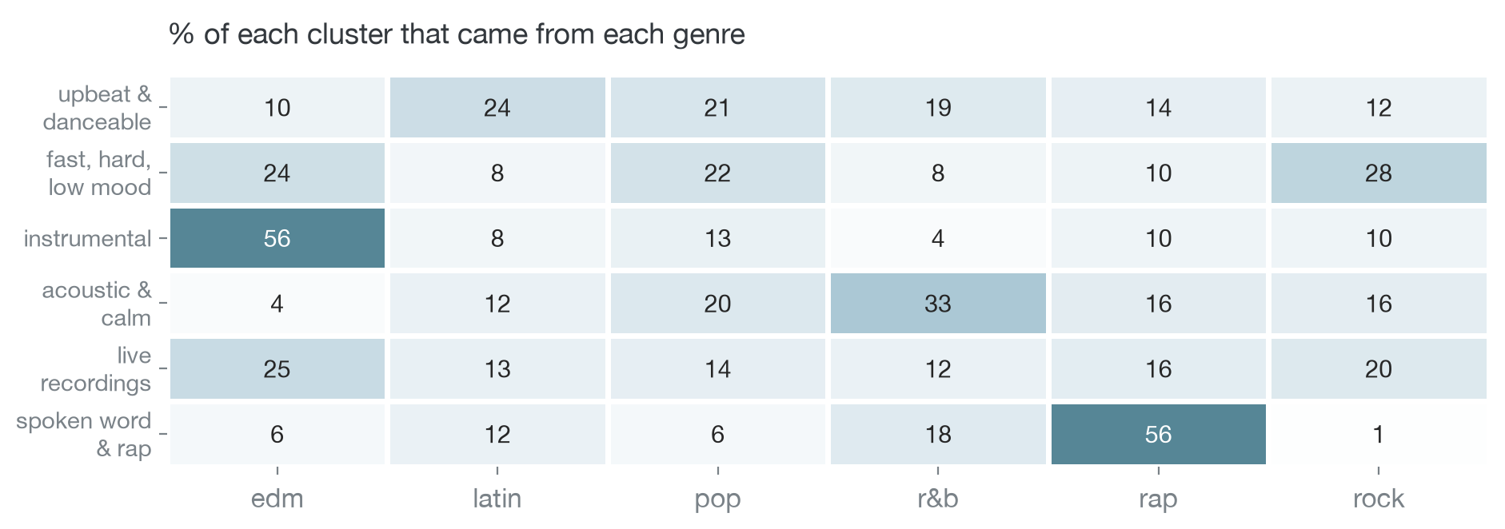
THE CHECK
So did it rediscover the genres?
We never showed it the genre column. Afterwards, we looked.
Partly. Rap and edm, yes. Everything else, no.
Rap has a sound signature (it's speech) and edm has one (it's instrumental), so those fell out cleanly. Pop, latin and rock smear across every group — because the genre label belongs to the playlist, not to the song.
clustering spotify songs
10

Slide 11
HONESTY
The part we're not going to hide
Our silhouette score is 0.155. On a scale where 0.7 means clean gaps between groups, that's low.
It isn't a bug. Songs don't come in islands — there is no empty space between "danceable" and "very danceable". Audio features slide into each other.
So K-Means didn't find gaps. It cut one big cloud into six useful regions.
The regions still earn their keep: each has one defining feature, a name, and a genre it leans towards. That's the bit that matters.
0.7
clear gaps between groups
0.155 ← us
groups touch each other everywhere
below 0
songs sitting in the wrong group. This is where GMM landed.
clustering spotify songs
11

Slide 12
RECOMMENDATION
What we'd actually do with this
Use K-Means, k = 6
Good for
Higher silhouette, and every group can be named. GMM's six groups came out looking almost identical to each other — nothing to call them.
Seeding playlists by mood. "More like this" recommendations. Tagging a catalogue by how things sound instead of by genre.
Not good for: guessing what will be a hit.
Cluster popularity only ranges from 29.7 to 42.7. Real, but small — and the EDA already showed no audio feature predicts a hit. What a song sounds like is not what makes it travel.
One thing we'd fix first: our cluster names are hard-coded to the numbers 0–5. Change a setting and the numbers shuffle while the names stay put.
clustering spotify songs
12

